Slide 1


Summaries of Technical Communication Module
2021.09 - 2021. 12
东南大学外国语学院研究生外语教学部版权所有 欢迎交流 盗用必究

Slide 2

Learning Patterns
Professional Skills
Cultural Studies
Ethical Research
东南大学外国语学院研究生外语教学部版权所有 欢迎交流 盗用必究

Slide 3
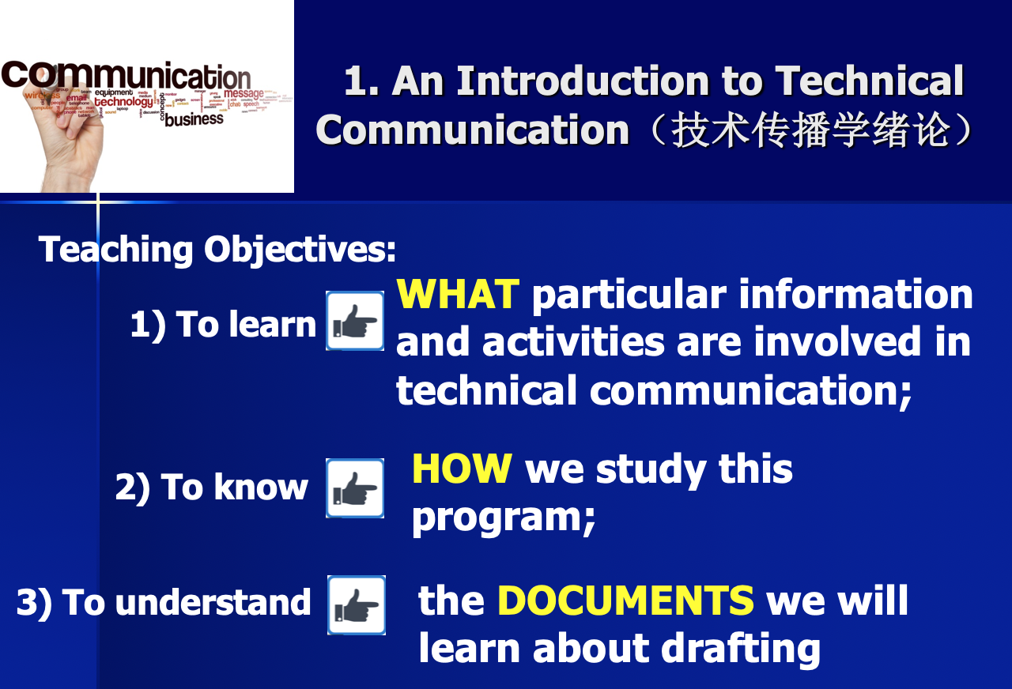
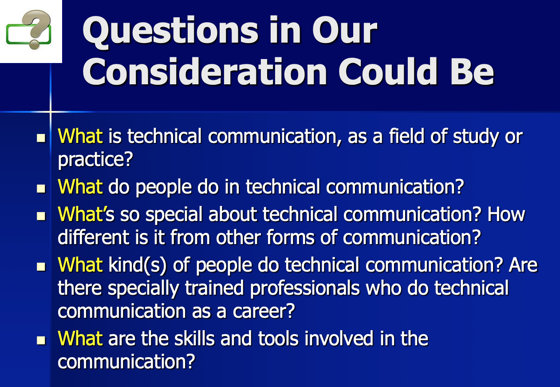
Introduction to Technical Communication:
东南大学外国语学院研究生外语教学部版权所有 欢迎交流 盗用必究

Slide 4
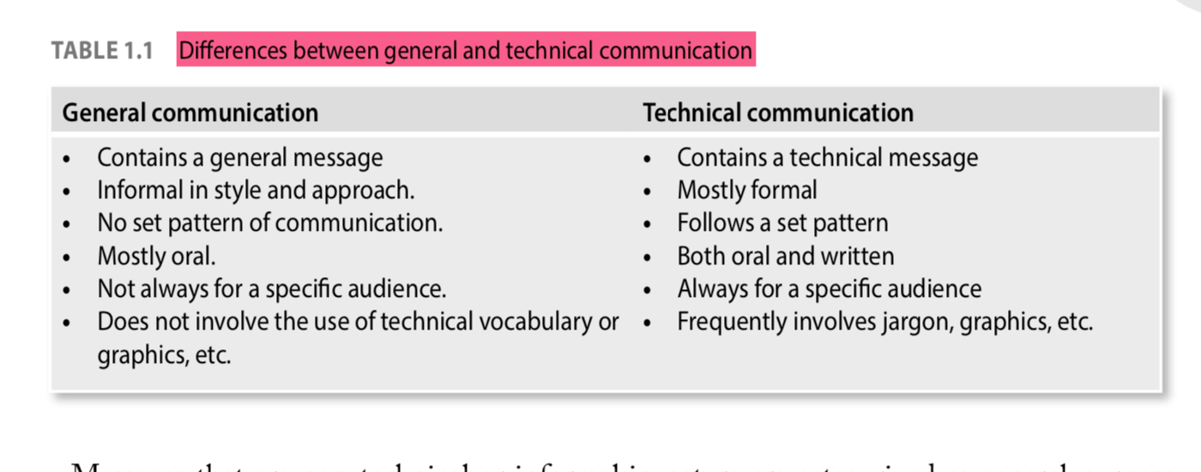
Introduction to Technical Communication:
Definition of Technical Communication
Technical communication is a process of managing technical information in ways that allow people to take action. (Richard Johnson-Sheehan)
2. Differences Between General Communication and Technical Communication
Reading Material, p. 3
东南大学外国语学院研究生外语教学部版权所有 欢迎交流 盗用必究

Slide 5
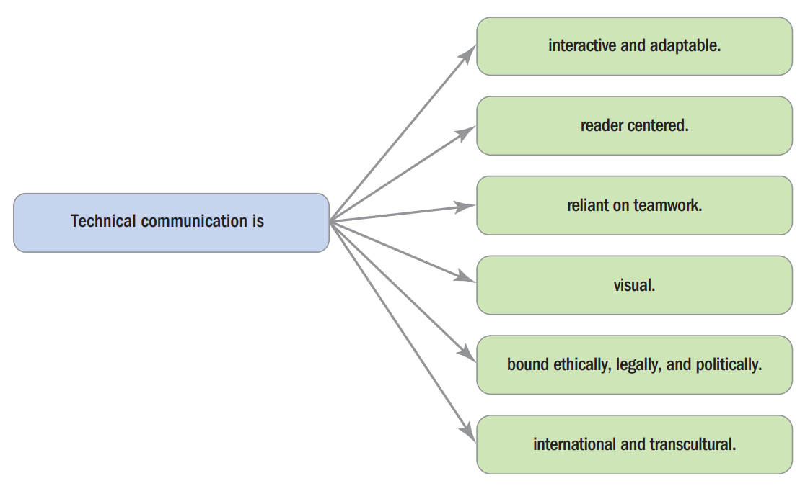

Introduction to Technical Communication:
3. Qualities of Technical Communication
东南大学外国语学院研究生外语教学部版权所有 欢迎交流 盗用必究

Slide 6

CONTENTS
Instructions and User’s Manuals
Résumés for Job Application
Emails for Work
Effective Memos
1. Designing
2. Drafting
东南大学外国语学院研究生外语教学部版权所有 欢迎交流 盗用必究

Slide 7

东南大学外国语学院研究生外语教学部版权所有 欢迎交流 盗用必究
Major Points
1
2
3
4
Clarifying
Designing
Drafting Instructions
Drafting Manuals
Definitions, Descriptions and Sets of Instructions
Way to Design Definitions
Types of Definitions
Guidelines for Writing Descriptions
4 Elements
Difference between the Instructions and the Manuals

Slide 8
1. Clarifying Terms
A definition is typically a brief explanation, using words and sometimes
graphics, of what an item is or what a concept means.
A description is typically a longer explanation—usually accompanied by
graphics—of the physical or operational features of an object, mechanism, or
process.
A set of instructions is a kind of process description, almost always accompanied
by graphics, intended to enable a person to carry out a task.
东南大学外国语学院研究生外语教学部版权所有 欢迎交流 盗用必究

Slide 9
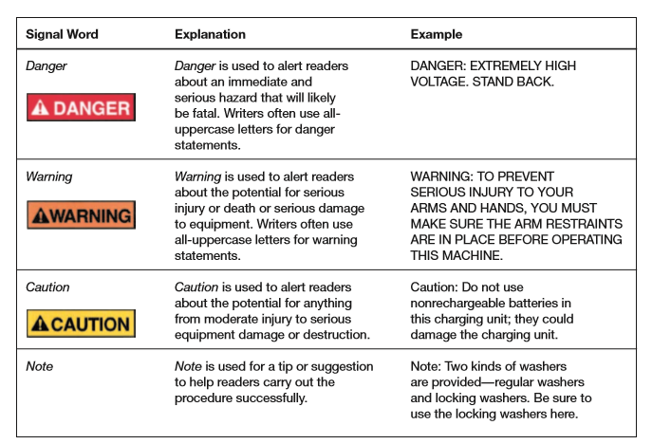
2. Designing Definitions and Descriptions
Ways to Design Definitions
(1) Creating a Glossary (for long documents)
(2) Using Simplified English
(3) Paying Attention to Key Terms
(4) Using Graphics
东南大学外国语学院研究生外语教学部版权所有 欢迎交流 盗用必究

Slide 10
2. Designing Definitions and Descriptions
Types of Definitions
(1) Parenthetical Definitions
(2) Sentence Definitions
(3) Extended Definitions
Guidelines for Writing Descriptions
(1) For Mechanism and Object Descriptions
(2) For Process Descriptions
东南大学外国语学院研究生外语教学部版权所有 欢迎交流 盗用必究

Slide 11
3. Drafting Effective Instructions
Title
(1) Being Simple and Clear
(2) Two Forms:
How–to
Gerund
Do not use the Noun String.
General Instruction
Basic Consideration on 6 Aspects (5W1HL): Who, Why, When, What Safety Measures, What Items, and How Long
东南大学外国语学院研究生外语教学部版权所有 欢迎交流 盗用必究

Slide 12
3. Drafting Effective Instructions
Do use the imperative mood.
Do not use the passive voice.
Do not omit articles.
e.g.
×Select program to scan.
√ Select a (the) program to scan.
Step-by-Step Instructions
8 Tips for Effective Drafting
Conclusion
Stating that the reader has now complete the task;
Describing what the reader should do next;
Ending with Maintenance Tips or A Troubleshooting Guide …
东南大学外国语学院研究生外语教学部版权所有 欢迎交流 盗用必究

Slide 13
4. Drafting User Manuals
no absolute distinction
main purpose shared: to explain how to carry our a task safely, effectively, and efficiently.
main difference: a manual has more elaborate front matter and back matter.
A set of instructions: 1~20 pages; for easier and simpler tasks, e.g. how to use a bar code scanner.
A manual: much longer and complex; for more complicated tasks or products, e.g., Airbus A380 Owners’ Workshop Manual
东南大学外国语学院研究生外语教学部版权所有 欢迎交流 盗用必究

Slide 14
Questions for Review:
Are the instructions designed effectively, with adequate white space and a clear relationship between the graphics and the accompanying text?
Do the instructions have a clear title?
Does the introduction to the set of instructions state the purpose of the task? Does it describe safety measures or other concerns that readers should understand? Does it list necessary tools and materials?
Are the step-by-step instructions numbered? Are they simple and direct?
Are appropriate graphics included?
Does the conclusion include any necessary follow-up advice? Or if appropriate, a troubleshooting guide?
东南大学外国语学院研究生外语教学部版权所有 欢迎交流 盗用必究

Slide 15
CONTENTS
Instructions and User’s Manuals
Résumés for Job Application
Emails for Work
Effective Memos
1. Basic Elements of a Chronological Résumé
2. Drafting a Cover Letter
东南大学外国语学院研究生外语教学部版权所有 欢迎交流 盗用必究

Slide 16
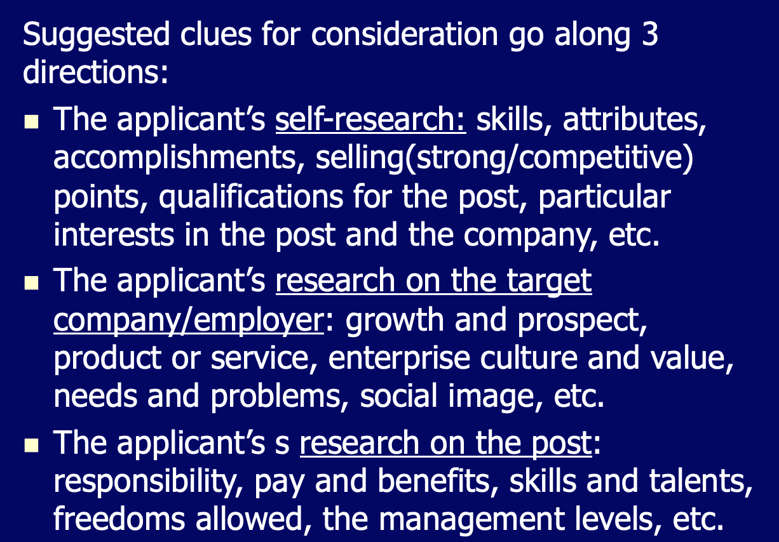
Professional Skills
Preparation
东南大学外国语学院研究生外语教学部版权所有 欢迎交流 盗用必究

Slide 17
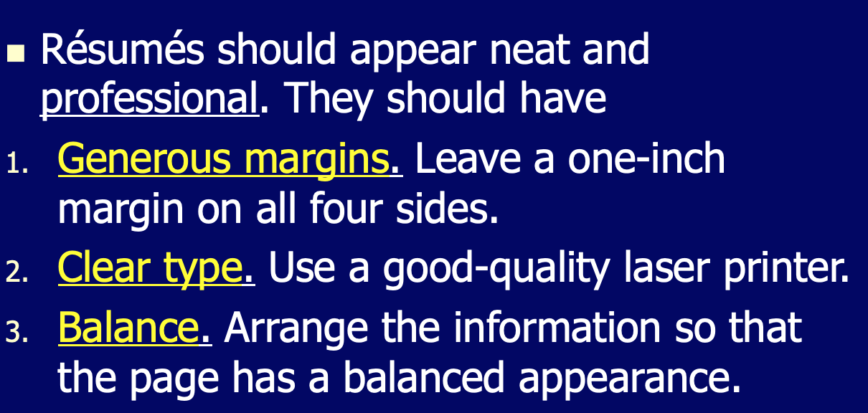
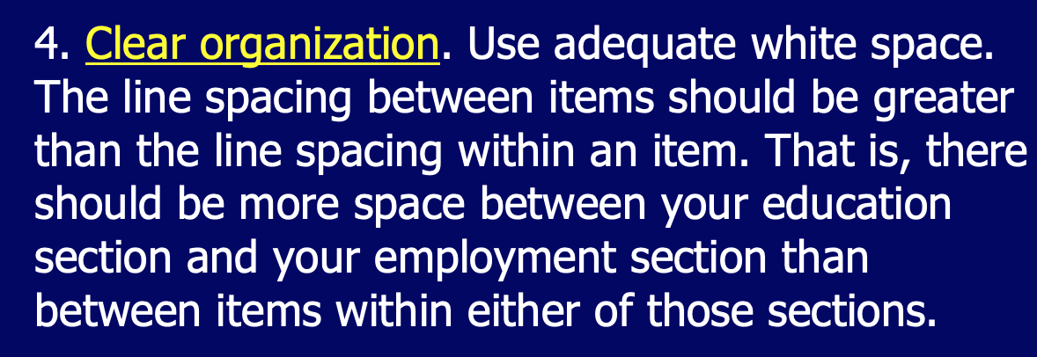
Professional Skills
Professional Appearance
东南大学外国语学院研究生外语教学部版权所有 欢迎交流 盗用必究

Slide 18
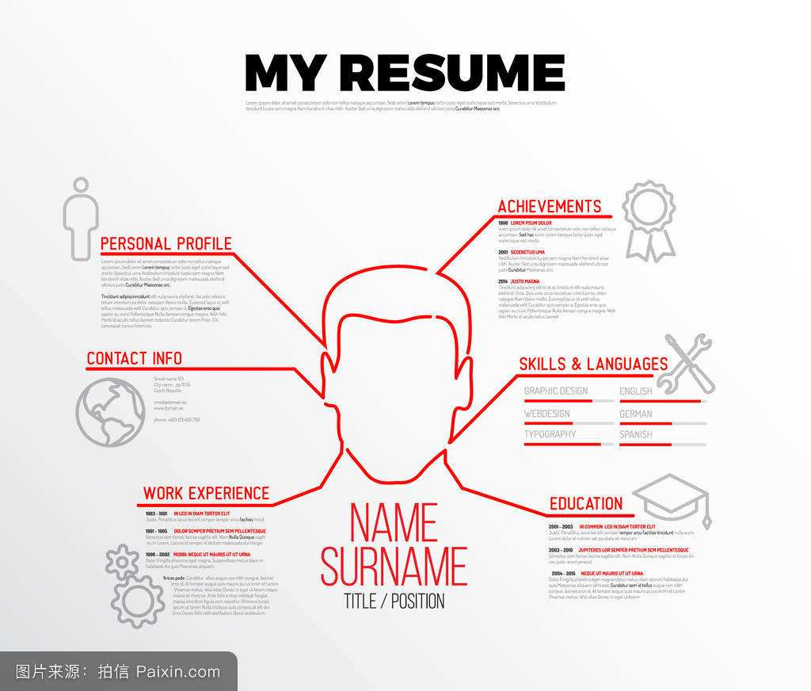
东南大学外国语学院研究生外语教学部版权所有 欢迎交流 盗用必究
Major Points
1. Types of the Résumés
2. Basic Elements of the Chronological Résumé
What to Include on Your Resume
1. Identification Information
Include your name, address, telephone number, and email address in the identification section at the top of your resume, or consider one of these other options for addressing your resume.
Use a professional email address.

Slide 19
东南大学外国语学院研究生外语教学部版权所有 欢迎交流 盗用必究
Major Points
2. Objective(optional)
Concise and specific; state your desired job or field, and what you hope to accomplish in that field.
3. Profile
Include a summary of your skills, experiences, and goals written specifically.
4. Education
Include the degrees you have received in reverse chronological order (with the most recent degree listed first).
Be sure to include the name of each institution, its location, and your date of graduation (or expected date of graduation).
When applicable, include your major/minor fields, as well as your GPA and any honors, publications, and projects.

Slide 20
Major Points
5. Experience
Include your work experience in reverse chronological order (with the most recent degree listed first).
This section can include jobs, internships, and volunteer work.
Include the name of the company, the position, and dates of employment.
List roughly three important tasks, accomplishments, or skills gained at each job.
Use action verbs to describe your achievements; avoid passive phrases such as responsible for and duties include.
东南大学外国语学院研究生外语教学部版权所有 欢迎交流 盗用必究

Slide 21
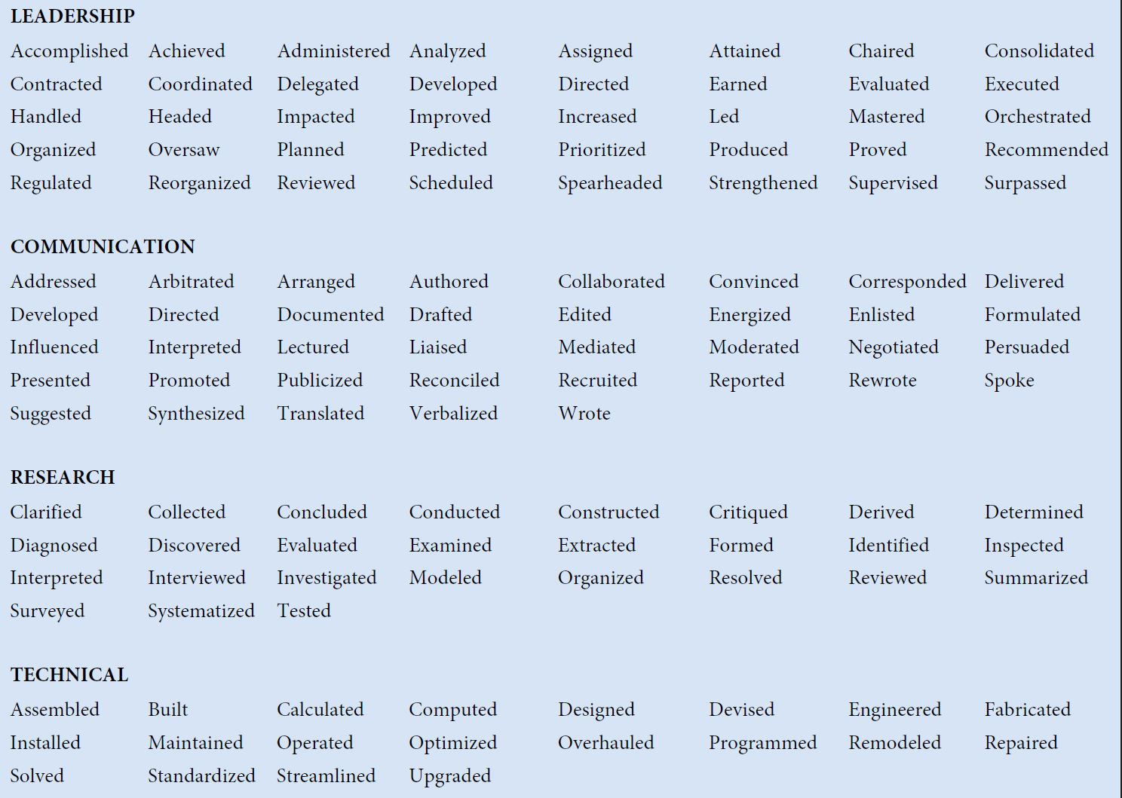
Action verbs for your resume 1
东南大学外国语学院研究生外语教学部版权所有 欢迎交流 盗用必究

Slide 22
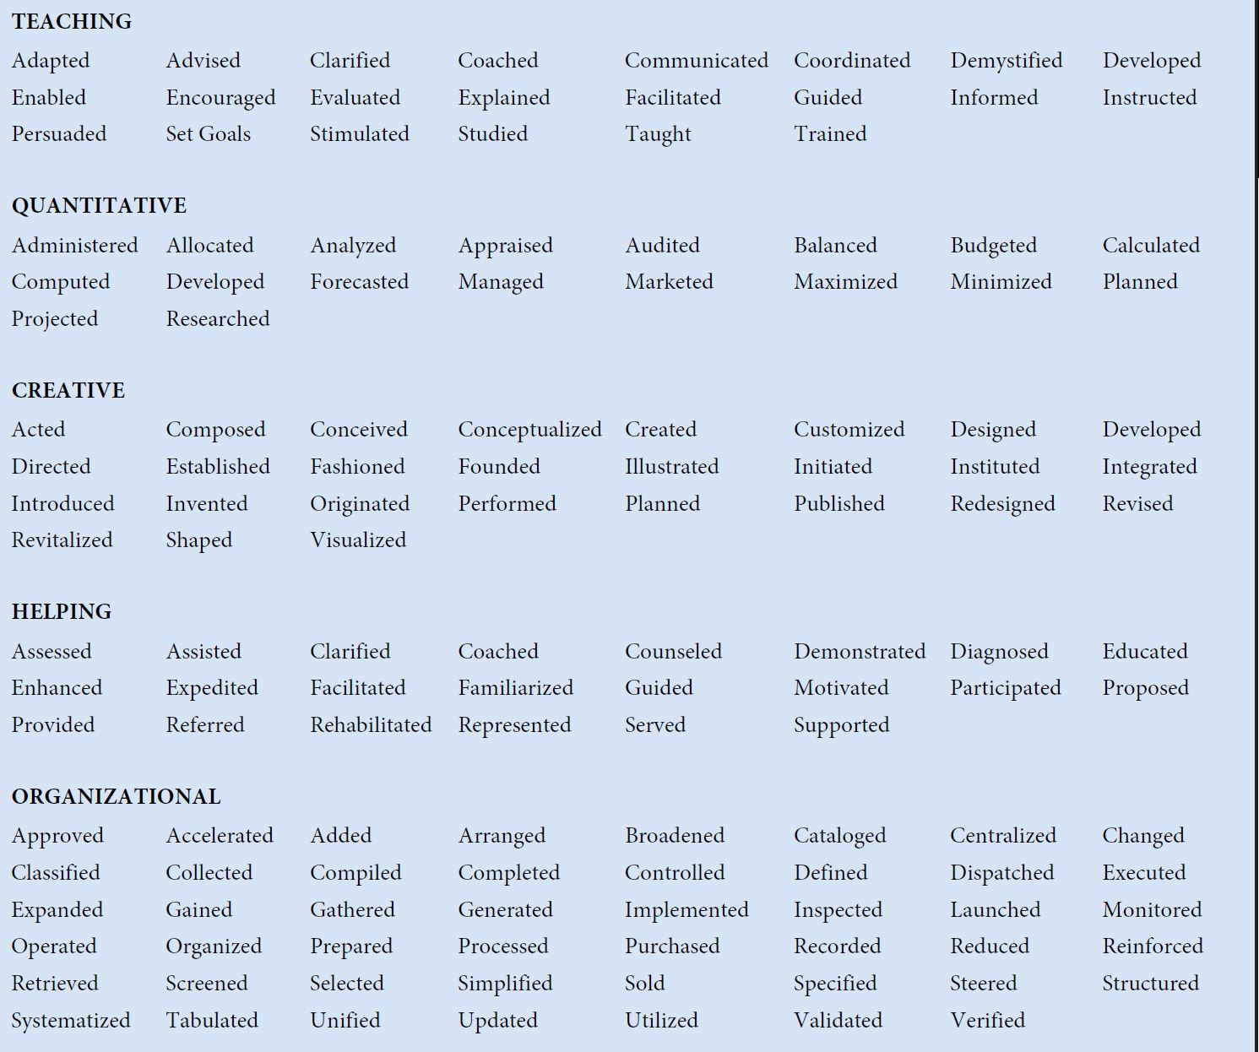
Action verbs for your resume 2
东南大学外国语学院研究生外语教学部版权所有 欢迎交流 盗用必究

Slide 23
Major Points
6. Skills (Optional)
Include any computer systems with which you are proficient, particularly if they are related to the position for which you are applying.
Include foreign languages with which you are familiar; state both the language and your level of familiarity (beginning, intermediate, proficient, fluent).
List any other skills you have that relate to the job but are not included elsewhere in your resume.
Volunteer Work (Optional)
Hobbies and Interests (Optional)
东南大学外国语学院研究生外语教学部版权所有 欢迎交流 盗用必究

Slide 24
Major Points
3. Differences between the Chronological Résumé and the Skills Résumé
4. Drafting a Cover Letter
Common purpose: proving that you have the right skills to excel at the job for which you are applying (Making a match for the job description in your résumé)
Definition
Structure
Contents
东南大学外国语学院研究生外语教学部版权所有 欢迎交流 盗用必究

Slide 25

Cultural and Ethical Notes
Understanding of Honesty
Writing Honest Job-application Materials
Misconducts and Consequences
东南大学外国语学院研究生外语教学部版权所有 欢迎交流 盗用必究

Slide 26
Questions for Review:
Does the résumé have a professional appearance, with generous margins, a balanced layout, adequate white space, and effective indentation?
Is the résumé honest?
Does the identifying information contain your name, address(es), phone number(s), and e-mail address(es)?
Does the résumé include a clear statement of your job objectives or a summary of your qualifications?
Does the education section include your degree, your institution and its location, and your (anticipated) date of graduation, as well as any other information that will help a reader appreciate your qualifications?
Does the employment section include, for each job, the dates of employment, the organization's name and location, and (if you are writing a chronological résumé) your position or title, as well as a description of your duties and accomplishments?
Does the interests-and-activities section include relevant hobbies or activities, including extracurricular interests?
Does the references section include the names, job titles, organizations, mailing addresses, and phone numbers of three or four references?
Does the résumé include any other appropriate sections, such as skills and abilities, military service, language abilities, or willingness to relocate?
东南大学外国语学院研究生外语教学部版权所有 欢迎交流 盗用必究

Slide 27

CONTENTS
Instructions and User’s Manuals
Résumés for Job Application
Emails for Work
Effective Memos
1. Format Elements of Emails for Work
2. Tips on Drafting Emails for Work
东南大学外国语学院研究生外语教学部版权所有 欢迎交流 盗用必究

Slide 28
Major Points
1. Format Elements of Emails for Work
Header, Message and Signature
2. Tips on Drafting Emails for Work
Netiquette Guidelines for Writing a Business Email
东南大学外国语学院研究生外语教学部版权所有 欢迎交流 盗用必究

Slide 29
东南大学外国语学院研究生外语教学部版权所有 欢迎交流 盗用必究
Style, Structure, and Content
Email messages must be kept brief; ideally, under 200 words.
The tone, i.e. the audience and purpose of the email, should be carefully considered.
Poor spelling and grammar in email messages could lead some readers to question the writer’s competence.
From: To: Cc: Bcc: Sent: Subject: Attachment:
Always take the time to consider the effect that the tone, style, grammar, and spelling of a mail may have on the recipient.
Header
Salutation
1. Purpose
2. Description of the Problem
3. Explanation of the Sender’s Ideas
Body
Message
What to do;
Courteous Ending
Close
Signature Block
Signature
Name;
Contact Information

Slide 30
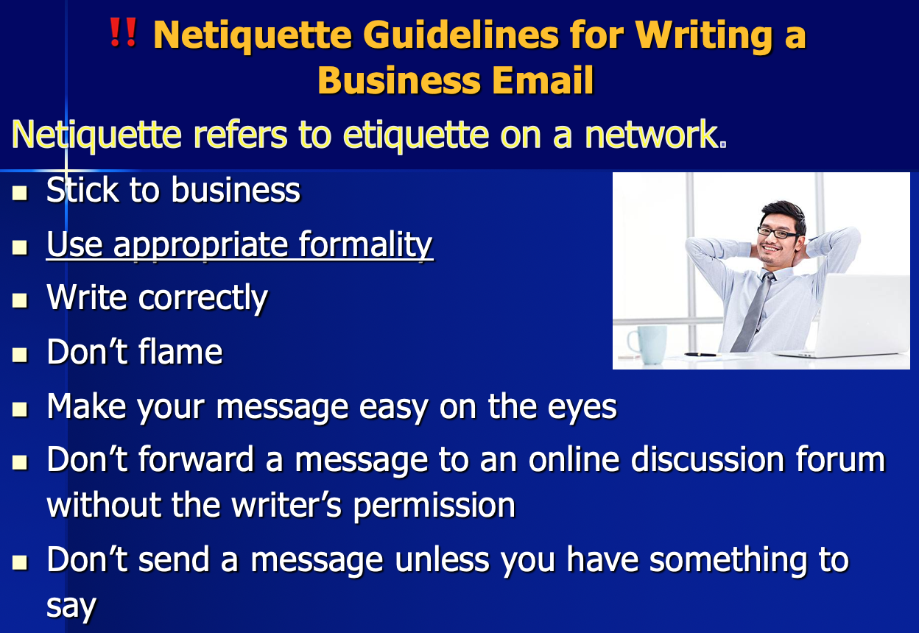
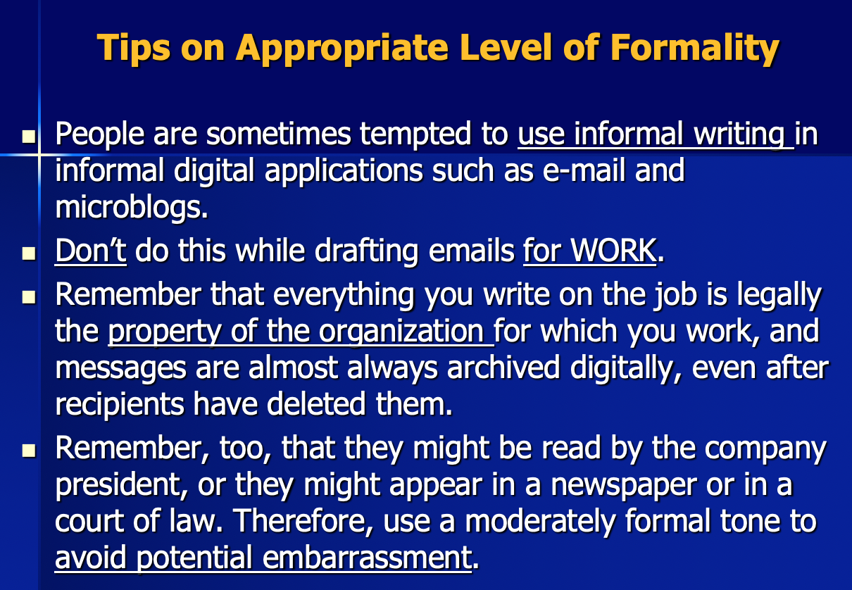
Reading Material, pp. 11-15
东南大学外国语学院研究生外语教学部版权所有 欢迎交流 盗用必究

Slide 31
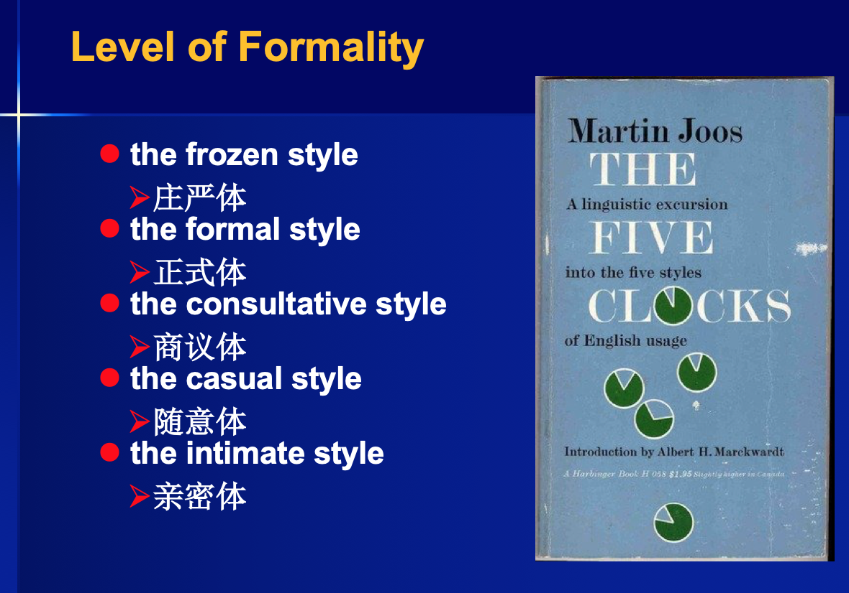
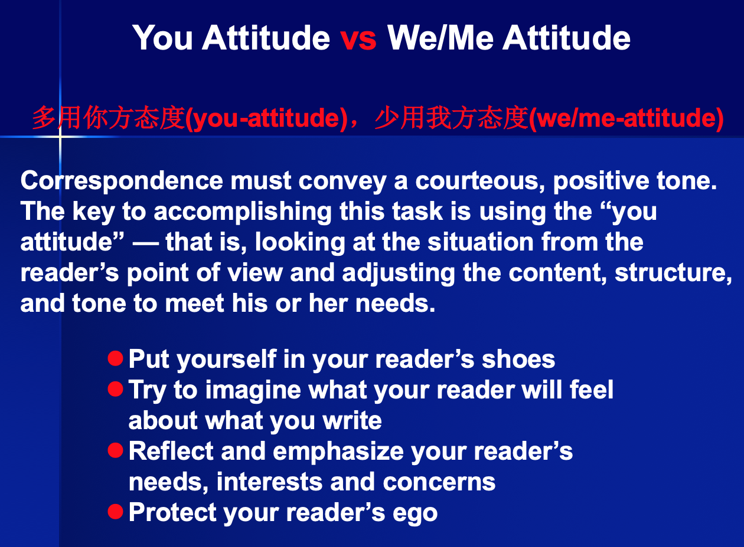
东南大学外国语学院研究生外语教学部版权所有 欢迎交流 盗用必究

Slide 32
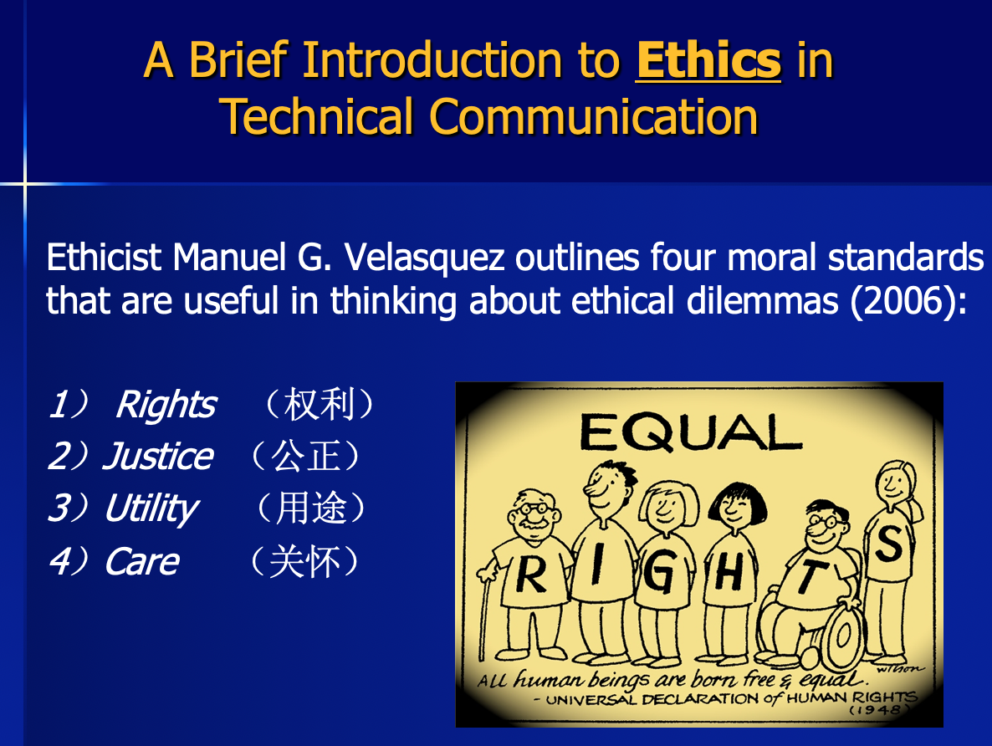
Ethical Research
Questions for Review:
Did you refrain from discussing nonbusiness subjects?
Did you keep the e-mail as brief as possible and send it only to appropriate people?
Did you use appropriate formality?
Did you write correctly?
Did you avoid flaming?
Did you write a specific, accurate subject line?
Did you use uppercase and lowercase letters?
Did you skip lines between paragraphs?
Did you keep the line length under 65 characters?
Did you check with the writer before forwarding his or her message?
东南大学外国语学院研究生外语教学部版权所有 欢迎交流 盗用必究

Slide 33
CONTENTS
Instructions and User’s Manuals
Résumés for Job Application
Emails for Work
Effective Memos
1. Memo Structure and Components
2. Cultural Study and Ethical Research
东南大学外国语学院研究生外语教学部版权所有 欢迎交流 盗用必究

Slide 34

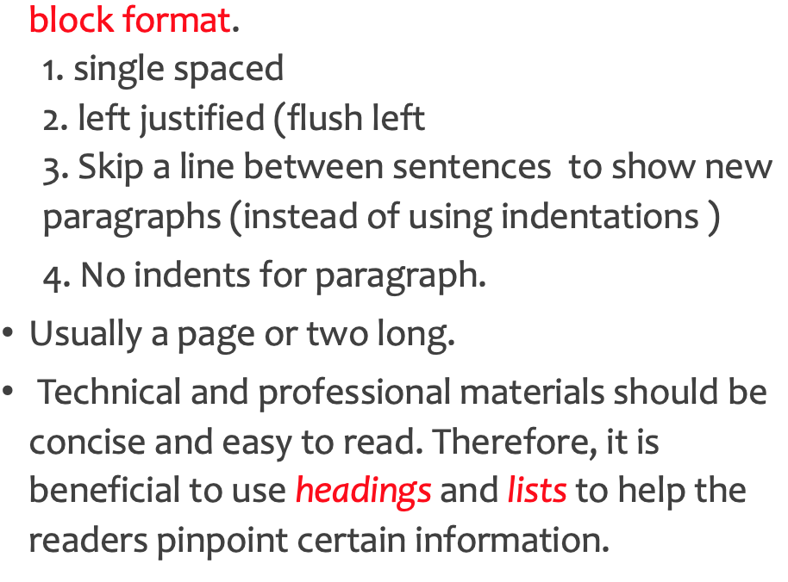
Major Points:
Introduction to Memos
Format of a Memo
Audience and Purpose
Parts of a Memo
Head, Opening, Discussion, Closing, Signature (basic);
Attachment and Distribution (optional)
Ethical Research
How to Avoid Misleading the Readers?
东南大学外国语学院研究生外语教学部版权所有 欢迎交流 盗用必究

Slide 35
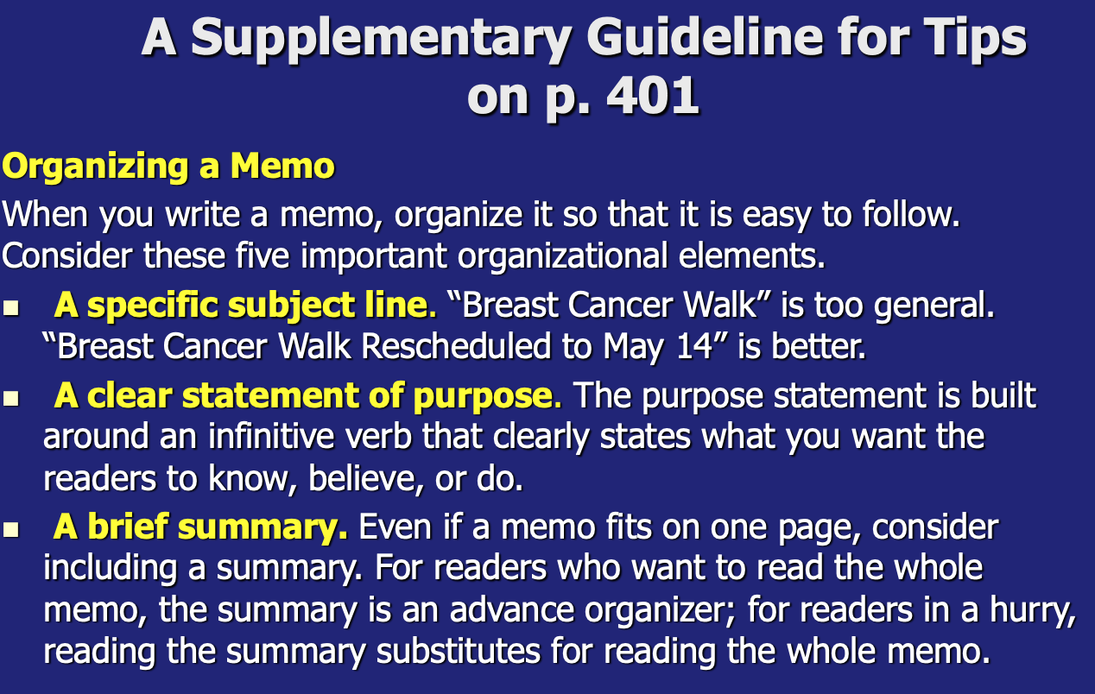
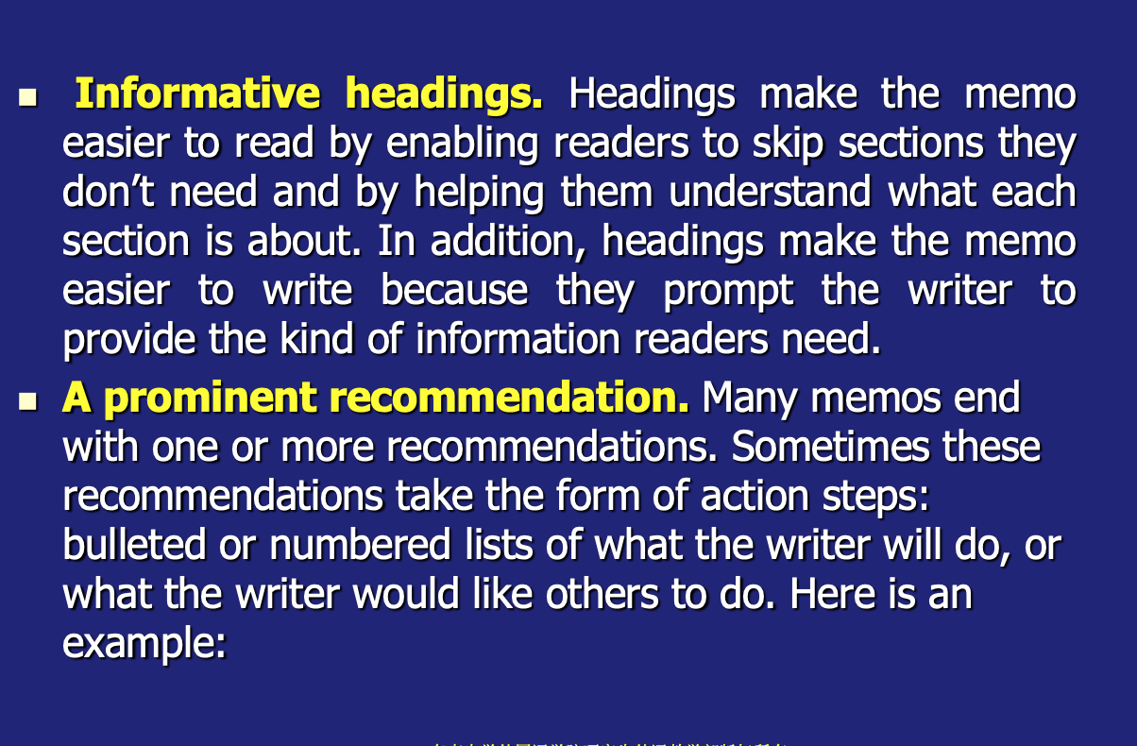
A Supplementary Guideline
Reading Material, p. 33
东南大学外国语学院研究生外语教学部版权所有 欢迎交流 盗用必究

Slide 36
Questions for Review:
Does the identifying information adhere to your organization’s standards?
Did you include a specific subject line?
Did you clearly state your purpose at the start of the memo?
Did you include informative headings to help your readers?
If appropriate, did you summarize your message?
Did you provide appropriate background for the discussion?
Did you organize the discussion clearly?
Did you highlight items requiring action?
东南大学外国语学院研究生外语教学部版权所有 欢迎交流 盗用必究

Slide 37




Good Luck!
&
Best Wishes!
东南大学外国语学院研究生外语教学部版权所有 欢迎交流 盗用必究

